Slide 1
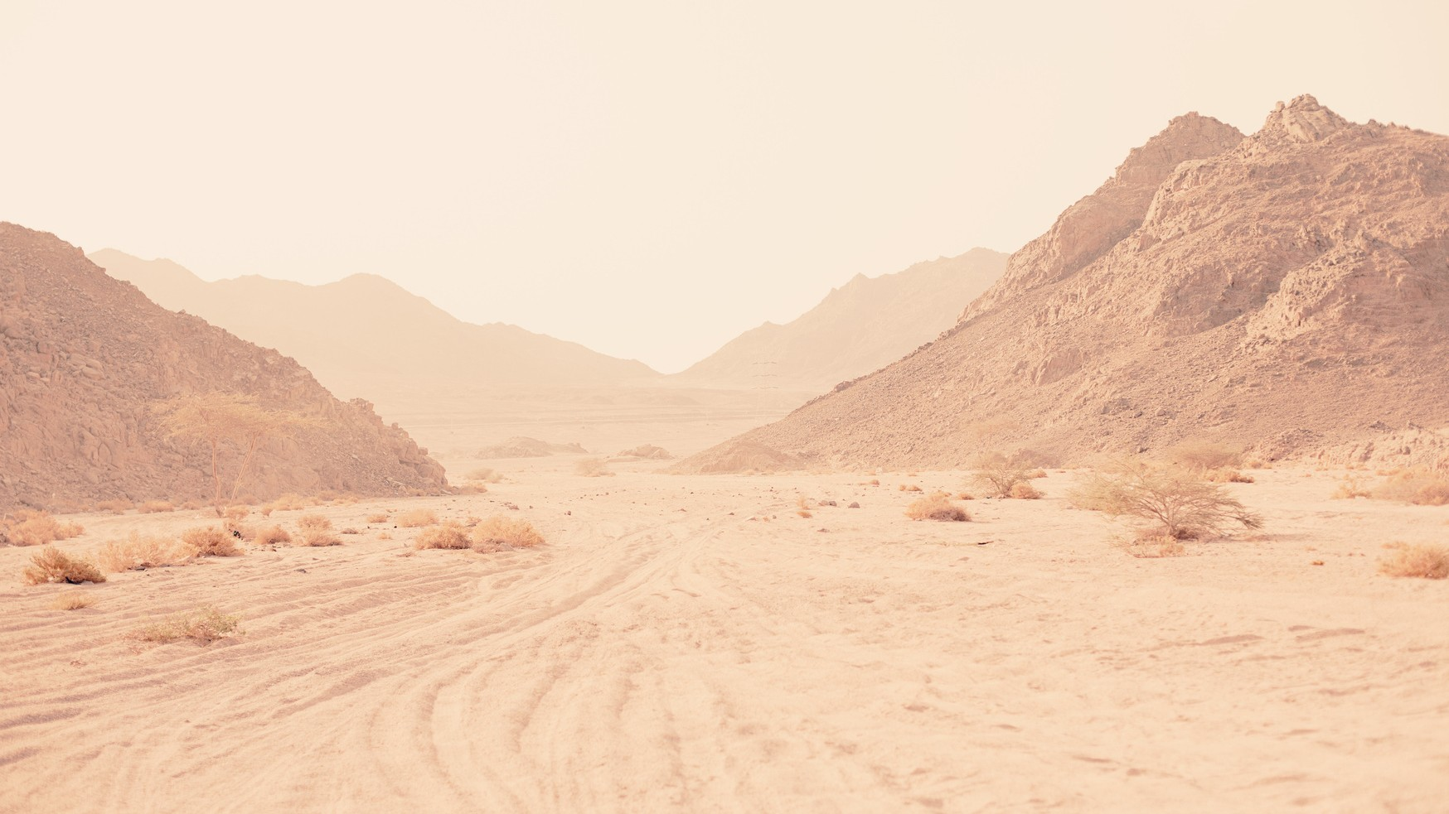

SEASON ONE · THE KINGDOM CREATED
KINGDOM COME
Week 2: We Rebel
Genesis 3–4 · Genesis 6 · Romans 5 · Ephesians 2
Notes:
Week 2: We Rebel — Leader's Guide.
Big Idea: Humanity rejected God's good rule, bringing sin and death into the world — but God responded to our rebellion with grace through Jesus Christ.

Slide 2
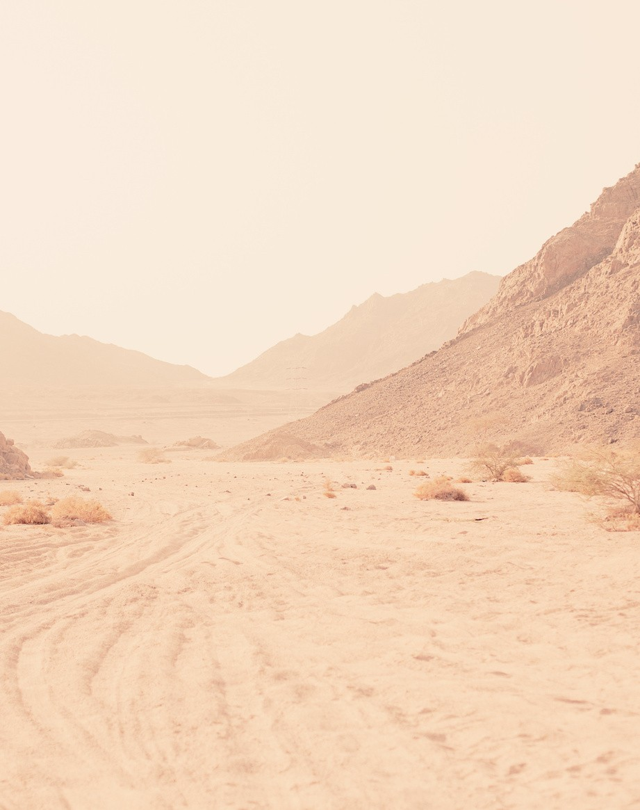
BIG IDEA
Humanity rejected God's good rule, bringing sin and death into the world — but God responded to our rebellion with grace through Jesus Christ.
OPENING QUESTION
When have you ignored instructions because you thought you knew a better way? How did it turn out?
KINGDOM COME / WEEK 2
Notes:
Opening question (full): Think of a time when you ignored instructions or advice because you thought you knew a better way. How did it turn out?
TRANSITION
We've all had moments when we thought, "I know what I'm doing. I've got this." Sometimes that's relatively harmless. But the Bible tells us that humanity's greatest problem began when we essentially said the same thing to God. Last week we saw a world created good by God. This week, everything changes. Humanity decides that rather than trusting God's wisdom and living under His good rule, we want to determine good and evil for ourselves. Genesis 3 introduces the great problem that drives the rest of the biblical story: rebellion against the King.

Slide 3
TONIGHT'S JOURNEY
From the garden to grace
1
2
3
4
5
We Reject God's Good Rule
Sin Breaks God's Good World
Sin Spreads
Adam's Rebellion Becomes Our Story
But God…
Genesis 3:1–7
Genesis 3:8–24
Genesis 4; Genesis 6:1–8
Romans 5:12–21
Ephesians 2:1–10
KINGDOM COME / WEEK 2
Notes:
Five movements tonight: Genesis 3:1–7 (we reject God's rule), Genesis 3:8–24 (sin breaks God's world), Genesis 4 and 6 (sin spreads), Romans 5 (Adam's rebellion becomes our story), Ephesians 2 (But God…).

Slide 4
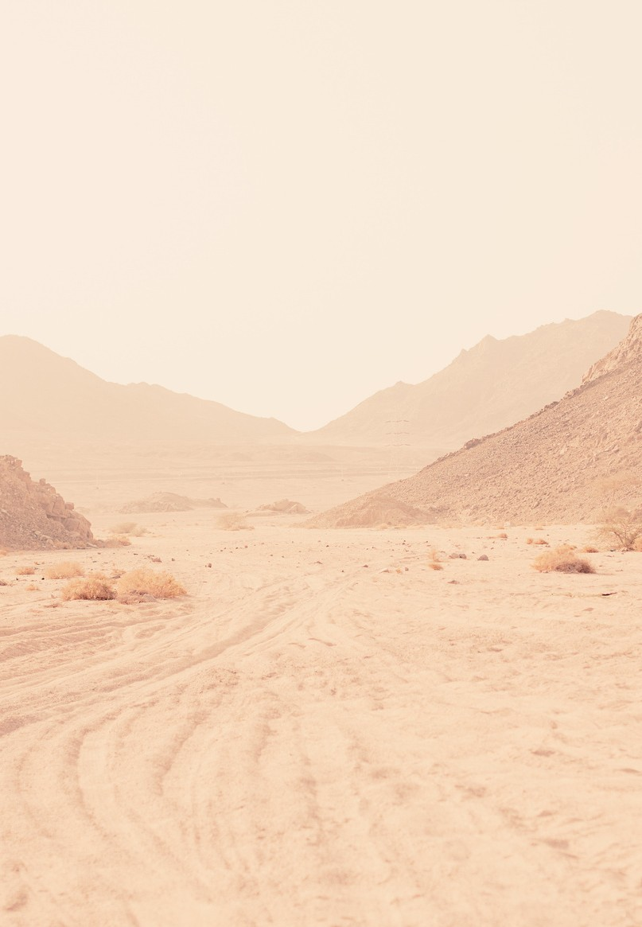
We Reject God's Good Rule
“Did God really say…?”
Temptation begins by questioning God
“You will be like God” — wanting His authority
Sin is rebellion against God's rightful rule
The lie: freedom is found outside God's rule
PART ONE
Genesis 3:1–7
KINGDOM COME / WEEK 2
Notes:
TALK TRACK
Genesis 3 begins with a world that is still exactly as God intended it to be. God has created humanity in His image, placed Adam and Eve in a beautiful garden, provided everything they need, and given them meaningful work and relationship with Him. God has also given them one clear boundary: they must not eat from the tree of the knowledge of good and evil.
Then the serpent enters the story with a question: "Did God really say...?" Notice how temptation begins. The serpent doesn't immediately tell Eve to reject God. Instead, he causes her to question God. Is God's Word really true? Is God's command really necessary? Is God really looking out for you? Could God actually be keeping something good from you?
Those questions lead to the serpent's promise in Genesis 3:5: "You will be like God, knowing good and evil." Ironically, Adam and Eve have already been made in God's image. But being God's image-bearers is no longer enough. Now they want God's authority. Rather than trusting God to determine what is good, they want to decide good and evil for themselves.
This gets to the heart of what sin really is. We often think of sin as breaking rules or doing bad things. Genesis 3 shows something deeper: sin is rebellion against God's rightful rule. At its core, sin says, "God, I don't trust You to determine what is best for me. I want to decide that for myself."
That same temptation continues today. We decide what is right based on our feelings, desires, circumstances, or culture rather than what God has said. Sometimes our rebellion is obvious; other times it looks respectable. Pride, self-sufficiency, bitterness, materialism, control, sexual sin, dishonesty, or simply living as though we don't need God all grow from the same root: I want to rule my own life.
The tragedy is that Adam and Eve rebel against a God who has only been good to them. His commands were an expression of His goodness. The serpent convinced them that freedom could be found outside God's rule. Humanity has been believing that lie ever since.
DISCUSSION
1. Where do you hear versions of the question "Did God really say?" in our culture today?
2. Why do you think it can be difficult for us to believe that God's boundaries are actually for our good?

Slide 5
PART TWO · GENESIS 3:8–24
Sin Breaks God's Good World
Sin doesn't just break God's rules — it breaks God's world
Shame
Blame
Brokenness
Hiding from God
Everyone points a finger
Relationships, work, death
A good world, deeply damaged by sin
KINGDOM COME / WEEK 2
Notes:
TALK TRACK
Adam and Eve eat the fruit expecting something better. Instead, almost immediately, everything begins to fall apart.
SHAME — They suddenly recognize their nakedness and try to cover themselves. Then they hear God approaching and do something they have never done before: they hide from Him. The relationship with God they once enjoyed is now fractured.
BLAME — When God confronts Adam, another relationship fractures. "The woman you gave to be with me — she gave me some fruit from the tree, and I ate." Adam blames Eve and subtly blames God. Eve blames the serpent.
BROKENNESS — Relationships become difficult. Childbearing involves pain. Work becomes frustrating. The ground produces thorns. And eventually human beings return to the dust. Sin doesn't simply break God's rules. Sin breaks God's good world.
Genesis 3 explains why the world we experience doesn't look like the "very good" world of Genesis 1. Our relationship with God is broken, our relationships with others damaged, our self-understanding distorted by guilt and shame, and our relationship with creation changed — frustrating work, sickness, aging, death. This explains what we all intuitively recognize: the world is beautiful, but something is terribly wrong with it.
We see it differently depending on our season of life. A teenager experiences brokenness through friendships, insecurity, or pressure to fit in. A young adult through relationships, career disappointments, or uncertainty. Parents in the struggles of raising children. Married couples when two sinful people build a life together. Older adults through loss, aging, or watching loved ones suffer. Genesis 3 gives us the explanation: we live in a good world that has been deeply damaged by sin.
DISCUSSION
1. How have you experienced the brokenness of the world differently at your current stage of life than you did ten or twenty years ago?
2. Why is it important for us to understand Genesis 3 when it comes to living out our daily lives?

Slide 6
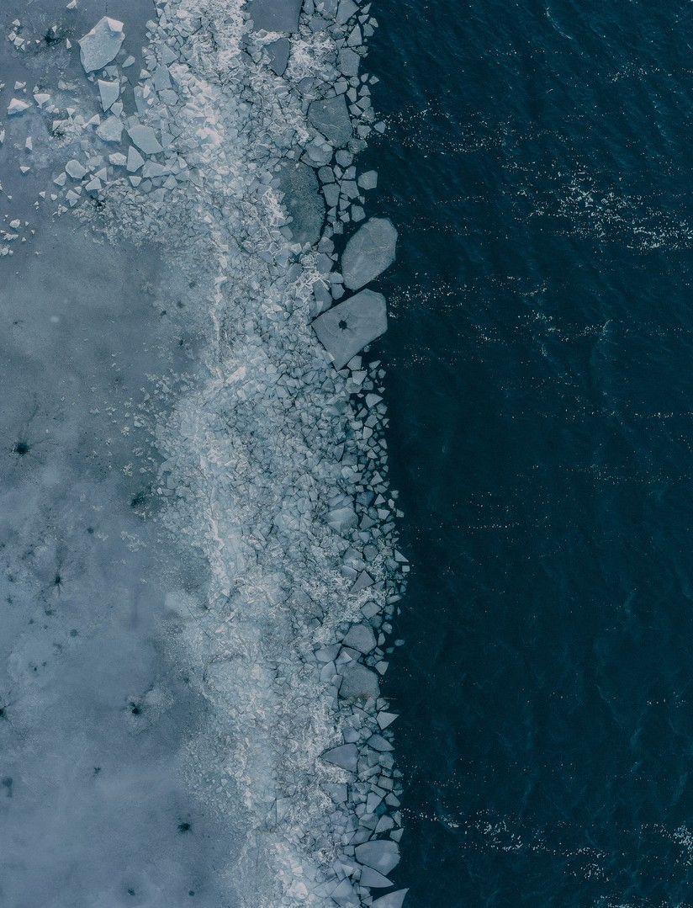
PART THREE · GENESIS 4; GENESIS 6:1–8
Sin Spreads
“Sin is crouching at the door… but you must rule over it.”
Genesis 3 → 4
Genesis 4 → 6
Fruit becomes murder
“Every inclination… only evil”
Sin doesn't stay small — yet Noah found favor
KINGDOM COME / WEEK 2
Notes:
TALK TRACK
If Genesis 3 showed the entrance of sin into the world, Genesis 4 and 6 show how quickly it spreads.
In Genesis 4, Cain and Abel bring offerings to God. When God accepts Abel's but not Cain's, Cain becomes angry. God warns him: "Sin is crouching at the door. Its desire is for you, but you must rule over it." Sin is pictured like a predator waiting outside the door. Cain has a choice — but rather than listening to God's warning, he lets anger and jealousy take control and murders his own brother.
Think how quickly the story deteriorates. In Genesis 3, Adam and Eve eat forbidden fruit. By Genesis 4, their son murders his brother. By Genesis 6, the problem has spread throughout humanity: "The LORD saw that human wickedness was widespread on the earth and that every inclination of the human mind was nothing but evil all the time."
Sin doesn't stay small. Anger becomes bitterness; bitterness becomes hatred. Pride destroys a relationship; selfishness damages a marriage; dishonesty destroys trust. One person's sinful choices can affect a family for generations. That's why God's warning to Cain matters for us. We tend to manage sin rather than confront it — excusing attitudes because they haven't produced obvious consequences yet. Scripture teaches us not to underestimate what sin can do.
Genesis 3–6 also shows that humanity cannot educate, organize, or improve its way out of the problem. The human heart itself has been corrupted. And yet, even in one of the darkest passages in Genesis, there is a hint that God has not abandoned humanity: "Noah, however, found favor with the LORD." Even as rebellion grows, God's grace keeps appearing in the story.
DISCUSSION
1. Why do you think we tend to underestimate the destructive power of "small" sins?
2. God warned Cain about sin before Cain murdered Abel. What are some practical ways we can deal with sin while it is still "crouching at the door"?

Slide 7
PART FOUR · ROMANS 5:12–21
Adam's Rebellion Becomes Our Story
“Sin entered the world through one man, and death through sin…”
1
2
3
Adam's story is ours
Two men, side by side
Where Adam failed
Not just out there — in here
Adam brings death; Jesus brings life
Jesus obeyed: “Not my will, but yours”
The faithful King succeeds where humanity failed
KINGDOM COME / WEEK 2
Notes:
TALK TRACK
Thousands of years after Genesis was written, Paul returns to the story of Adam to explain why Genesis 3 matters so much. Romans 5:12: "Just as sin entered the world through one man, and death through sin, in this way death spread to all people, because all sinned."
Adam's rebellion brought sin and death into the human story. But Paul won't let us treat Adam's sin as an unfortunate event from the distant past. Adam's story has become our story. Every one of us is part of the rebellion. We aren't merely victims of a broken world; we also contribute to its brokenness.
That's important for Christians to remember. It is easy to look at the world and identify everything wrong with everyone else — cultural, moral, political, family problems, younger or older generations. But Scripture forces us to look in the mirror. The rebellion isn't just "out there." It is in here.
But Romans 5 doesn't end with Adam. Paul introduces another man: Jesus Christ. He deliberately places them side by side. Adam's disobedience brings condemnation; Jesus' obedience brings righteousness. Adam brings death; Jesus brings life. Adam's rebellion affects humanity; Christ's obedience opens the way for grace and salvation.
Jesus does what Adam failed to do. Adam stood in a perfect garden and distrusted God. Jesus faced temptation, suffering, rejection, and the cross — and perfectly trusted and obeyed His Father. Where Adam said, in effect, "My will be done," Jesus prayed, "Not my will, but yours, be done." Jesus came as the faithful King who succeeds where humanity failed, and through His death and resurrection He begins to undo the damage caused by our rebellion.
DISCUSSION
1. How should recognizing our own sin affect the way Christians treat people who don't know Christ?
2. What about those in our own church?

Slide 8
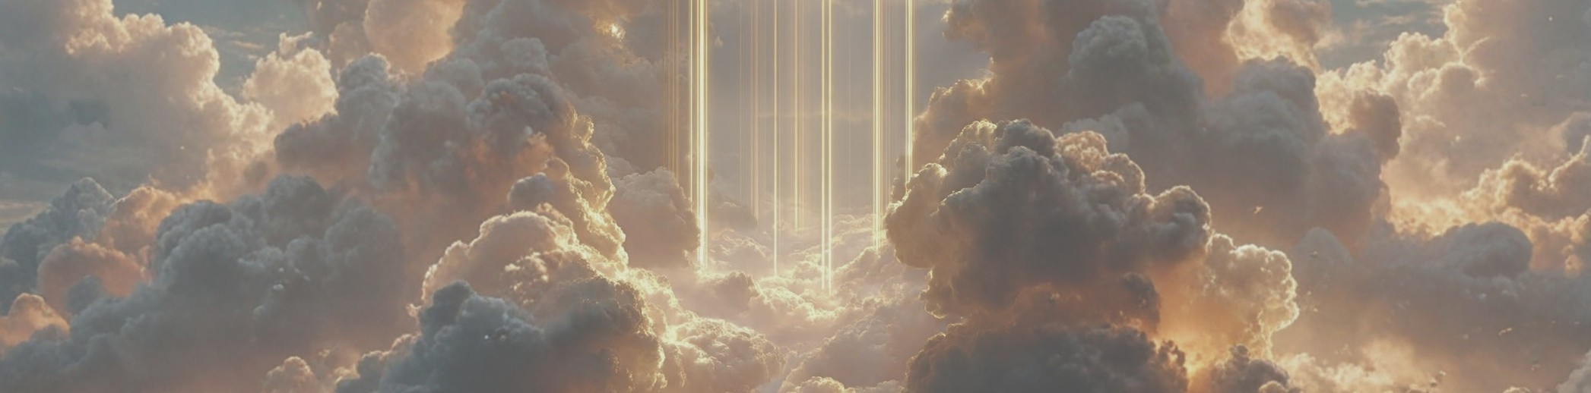
PART FIVE · EPHESIANS 2:1–10
But God…
“But God, who is rich in mercy… made us alive with Christ.”
Dead, not sick
Rescued, not self-made
Created for good works
A dead person needs life, not advice
We don't climb back — God comes for us
Grace gives a new way to live
KINGDOM COME / WEEK 2
Notes:
TALK TRACK
Ephesians 2 gives an even clearer picture of our condition apart from Christ. Paul doesn't describe us as basically good people who occasionally make mistakes, or even as sick people who need some help. He says we were dead in our trespasses and sins. That's a much more serious diagnosis. A dead person doesn't need advice, encouragement, or to try harder. A dead person needs life.
Apart from Christ we followed the ways of the world and the desires of our sinful nature. Genesis 3 isn't just Adam and Eve's story; it's ours. Then we arrive at two of the most important words in this week's lesson: "But God..." We rebelled. But God… We followed our own desires. But God… We were spiritually dead. But God…
"But God, who is rich in mercy, because of his great love that he had for us, made us alive with Christ." That is the gospel. Christianity is not the story of rebellious people finally finding their way back to God. It is the story of God coming to rescue people who could never rescue themselves. He saves us not because we deserve it, but because He is rich in mercy and great in love. "For you are saved by grace through faith, and this is not from yourselves; it is God's gift — not from works, so that no one can boast." We don't climb our way back to God. God comes for us.
But grace doesn't simply forgive our rebellion; it gives us a new way to live. Verse 10: we are God's workmanship, created in Christ Jesus for good works that God prepared for us to do. In Genesis, God created humanity with a purpose. Sin distorted it. Through Jesus, God is making us new and restoring us to the life for which we were created.
The rebel can come home. The spiritually dead can be made alive. The person who once said, "I want to rule my own life," can now say, "Jesus is King. I belong to Him." That is where we find our place in the Kingdom.
DISCUSSION
1. Why do you think Paul uses the word "dead" to describe our condition apart from Christ? How is that different from simply saying people need to become better?
2. How does understanding the seriousness of our sin help us appreciate the greatness of God's grace?
3. Verse 10 says God has prepared good works for us to do. What might it look like for someone in your current stage of life to live out that new purpose this week?

Slide 9
CLOSING
Five Key Truths
1
2
3
4
5
Sin Is Rebellion Against God's Good Rule
Sin Has Broken God's Good World
Sin Spreads Farther Than We Expect
We Cannot Rescue Ourselves
Jesus Came to Rescue Rebels
My way, not God's way
Beautiful and broken
Heart → home → world
Dead, not just sick
Saved by grace
KINGDOM COME / WEEK 2
Notes:
TALK TRACK
1. Sin Is Rebellion Against God's Good Rule — Sin is more than breaking a list of rules. At its core, sin is our attempt to take God's place and determine for ourselves what is good. Every sin grows from the same basic rebellion: "I want my way instead of God's way."
2. Sin Has Broken God's Good World — Genesis 3 explains why the world we experience is both beautiful and broken. Sin has damaged our relationship with God, ourselves, one another, and creation. The pain and brokenness we experience were never part of God's original design.
3. Sin Spreads Farther Than We Expect — Genesis 3 becomes Genesis 4, and Genesis 4 eventually becomes Genesis 6. Sin that begins in the heart doesn't stay there. Our choices affect our relationships, families, communities, and sometimes generations after us.
4. We Cannot Rescue Ourselves — Our greatest problem isn't simply around us; it is within us. Apart from Christ we are spiritually dead. We don't need minor improvements or better behavior. We need God to make us alive.
5. Jesus Came to Rescue Rebels — Where Adam disobeyed, Jesus obeyed. Where Adam brought death, Jesus brings life. We are saved by grace, not because we worked our way back to God, but because God came for us in Jesus Christ.
As you think about these five truths, which one do you most need to remember this week?

Slide 10





REFLECT
Which truth do you most need this week?
An area where you've been resisting God's rule
God's help with sin “crouching at the door”
Letting God examine your own heart, not everyone else's
Resting in grace instead of earning acceptance
Jesus can restore what feels hopelessly broken
KINGDOM COME / WEEK 2
Notes:
Ask the group: which of these do you most need to remember this week?
• Do you need to recognize an area where you have been resisting God's rule?
• Do you need God's help dealing with sin that is "crouching at the door"?
• Do you need to stop focusing on everyone else's sin and allow God to examine your own heart?
• Do you need to stop trying to earn God's acceptance and rest in His grace?
• Do you need to remember that Jesus can bring life and restoration to something that feels hopelessly broken?

Slide 11
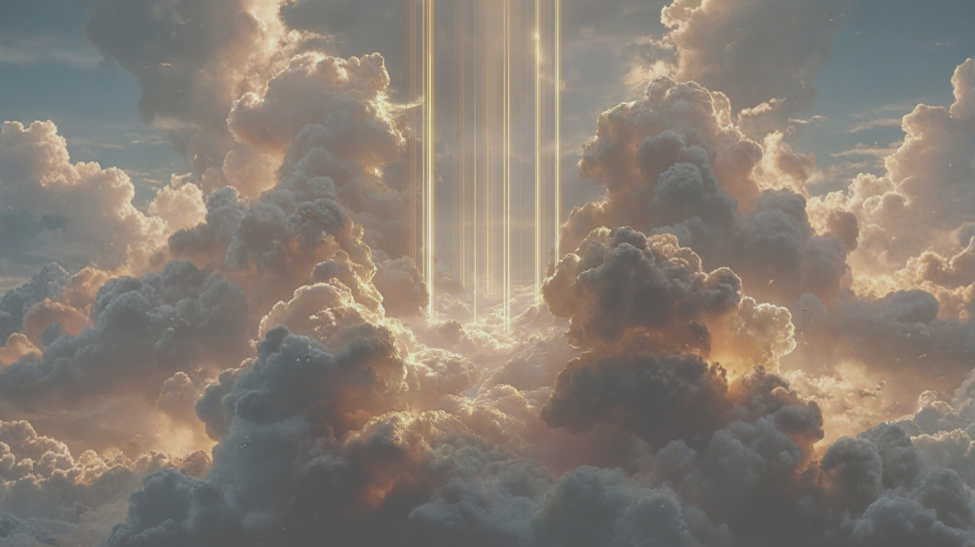
FINAL CHALLENGE
The King we rejected came to save us
Our rebellion sets the stage for the great rescue mission of Scripture.
Notes:
FINAL CHALLENGE
Last week we learned that God created us and gave us a place in His story. This week we discover what went wrong: we rejected the King and tried to take His place. But thankfully, that isn't the end of the story. Our rebellion sets the stage for the great rescue mission that unfolds throughout the rest of Scripture. The King we rejected is the very King who comes to save us.
CLOSING PRAYER
Father, You created us for Yourself and have only been good to us, yet we confess that we often choose our own way instead of Yours. We see the effects of sin in the world around us, but we also recognize the rebellion within our own hearts. Thank You that You did not abandon us. Thank You that while we were spiritually dead, You made a way for us to have life through Jesus. Thank You for Your mercy, Your grace, and Your great love. Help us trust Your goodness, submit to Your rule, and live this week as people who belong to Your Kingdom. Amen.

Slide 12

KEEP GOING · WEEK TWO READING PLAN · SEPT 7–11
This week: We Rebel
MON
TUE
WED
THU
FRI
Genesis 3
Genesis 4
Genesis 6:1–8
Romans 5
Ephesians 2
USE THIS SIMPLE PROCESS WITH EACH DAY'S READING
Read
Reflect
Believe
Desire
Do
Pray
The day's passage
What is God showing me?
What truth do I trust?
What should I long for?
What action do I take?
Ask Him to help you live it
KINGDOM COME / WEEK 2
Notes:
Week 2 (SEPT 7–11): We Rebel — Genesis 3, Genesis 4, Genesis 6:1–8, Romans 5, Ephesians 2.
Reading plan process (full text):
Read — Read the assigned Scripture passage.
Reflect — What does God want me to see about Himself, His people, or His plan?
Believe — What promise, truth, or aspect of God's character should I trust today?
Desire — What should I love, value, pursue, or long for?
Do — What actions should I take or changes should I make in my life?
Pray — Talk to God about what you have learned and ask Him to help you live it out.

Slide 13
KEEP GOING · WEEK THREE READING PLAN · SEPT 14–18
Next week: God Judges & Preserves
MON
TUE
WED
THU
FRI
Genesis 6
Genesis 7
Genesis 8
Genesis 9
Genesis 11
USE THIS SIMPLE PROCESS WITH EACH DAY'S READING
Read
Reflect
Believe
Desire
Do
Pray
The day's passage
What is God showing me?
What truth do I trust?
What should I long for?
What action do I take?
Ask Him to help you live it
KINGDOM COME / WEEK 2
Notes:
Week 3 (SEPT 14–18): God Judges & Preserves — Genesis 6, Genesis 7, Genesis 8, Genesis 9, Genesis 11.
Reading plan process (full text):
Read — Read the assigned Scripture passage.
Reflect — What does God want me to see about Himself, His people, or His plan?
Believe — What promise, truth, or aspect of God's character should I trust today?
Desire — What should I love, value, pursue, or long for?
Do — What actions should I take or changes should I make in my life?
Pray — Talk to God about what you have learned and ask Him to help you live it out.

